Slide 1
FROZENC SPARE PARTS DISASSEMBLY / ASSEMBLY MANUAL

Slide 2
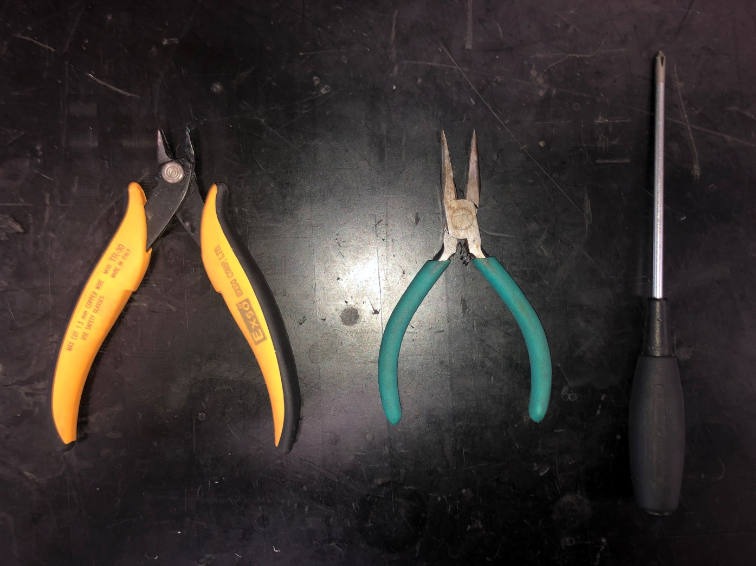
TOOLS NEEDED FOR DISASSEMBLY
(From Left to Right) 1. Nipper 2. Long Nose Plier 3. Plus Driver

Slide 3
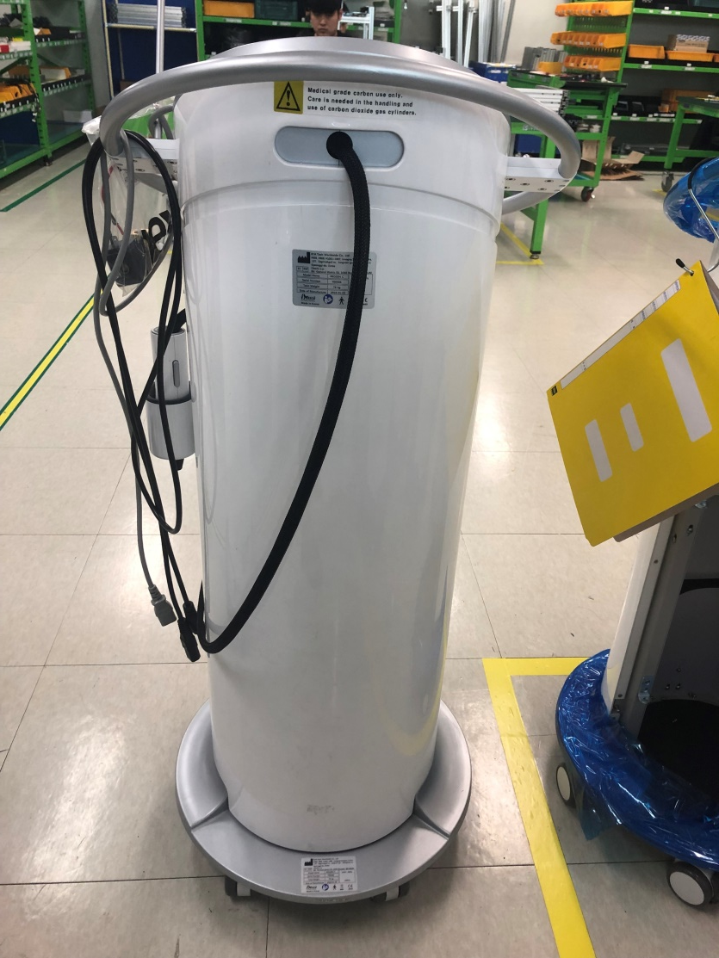
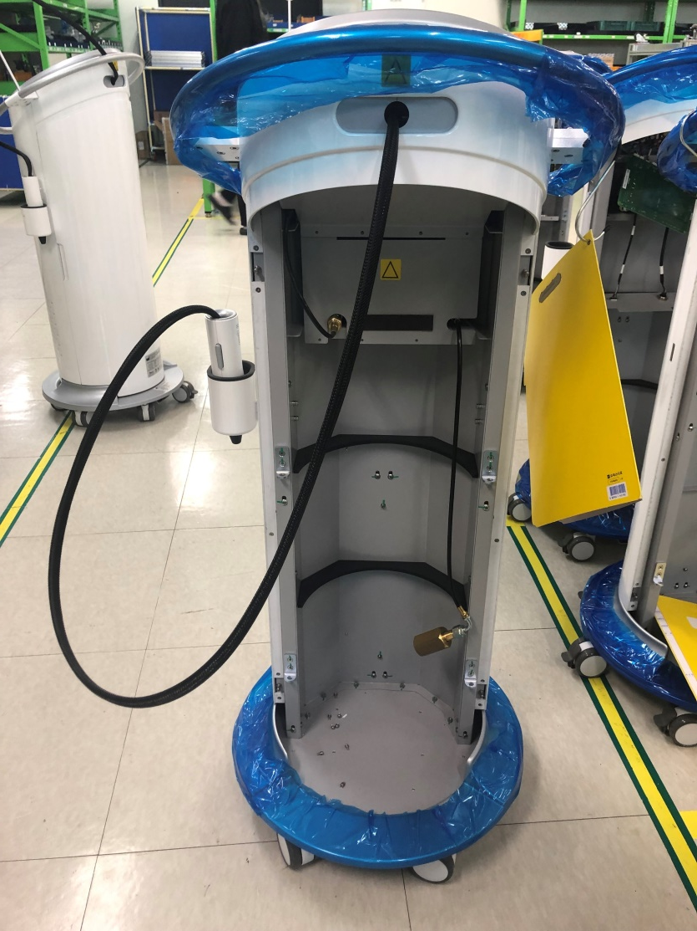
DISASSEMBLE F/C (FROZENC)
1 Take off back cover

Slide 4
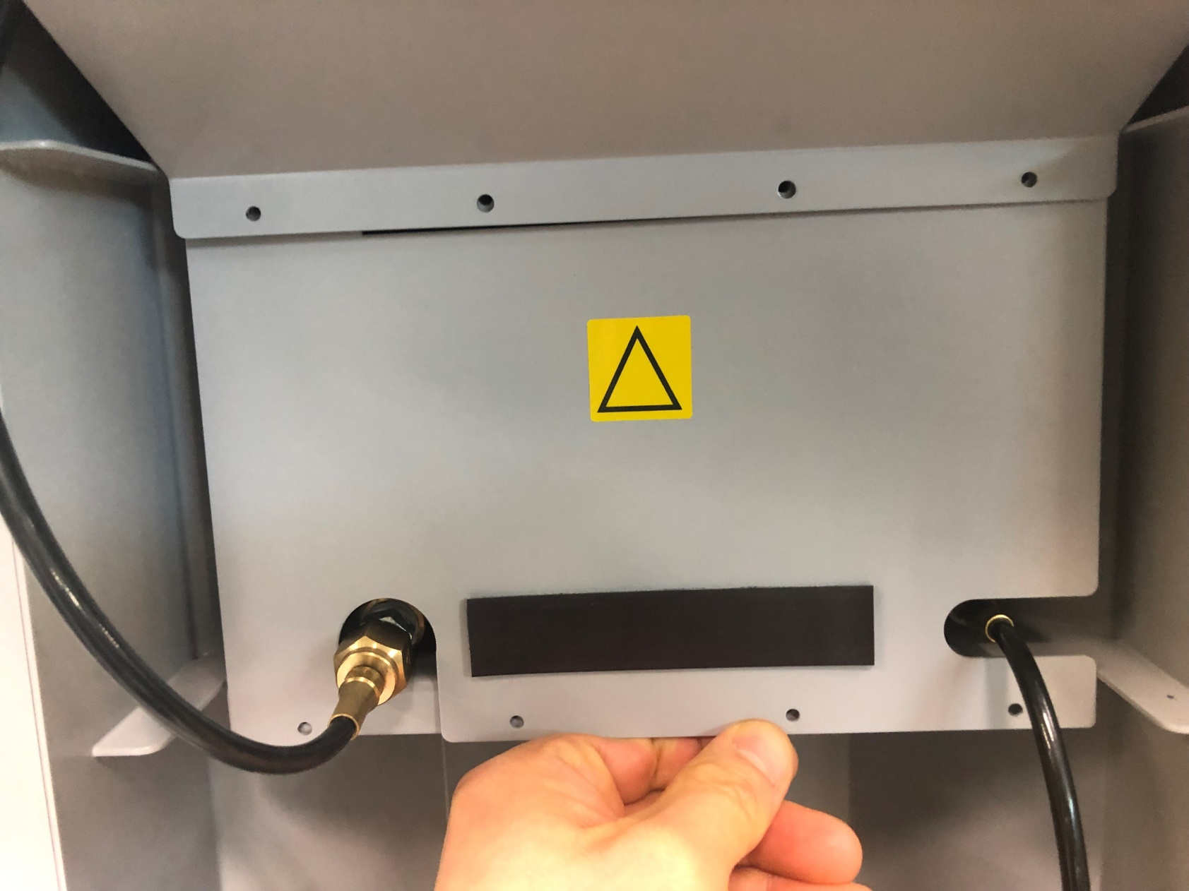
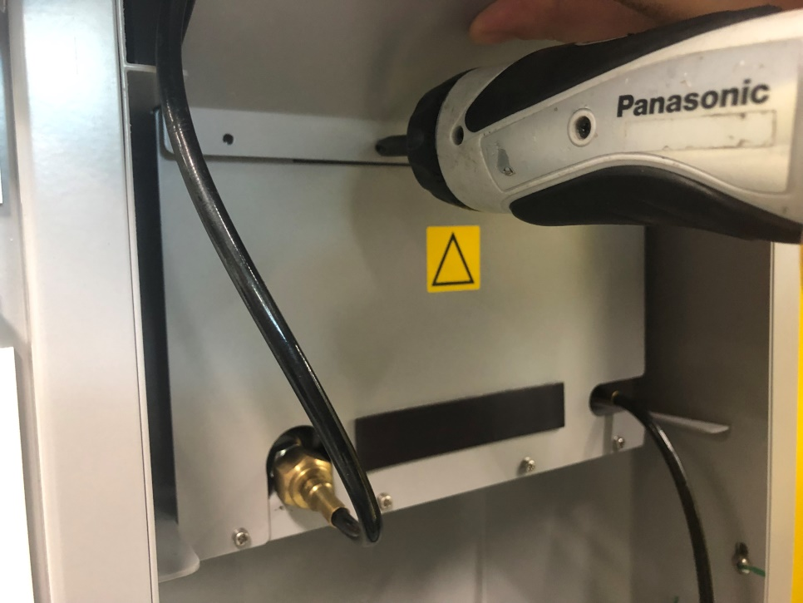
2 Unwind screw bolts on circle area

Slide 5
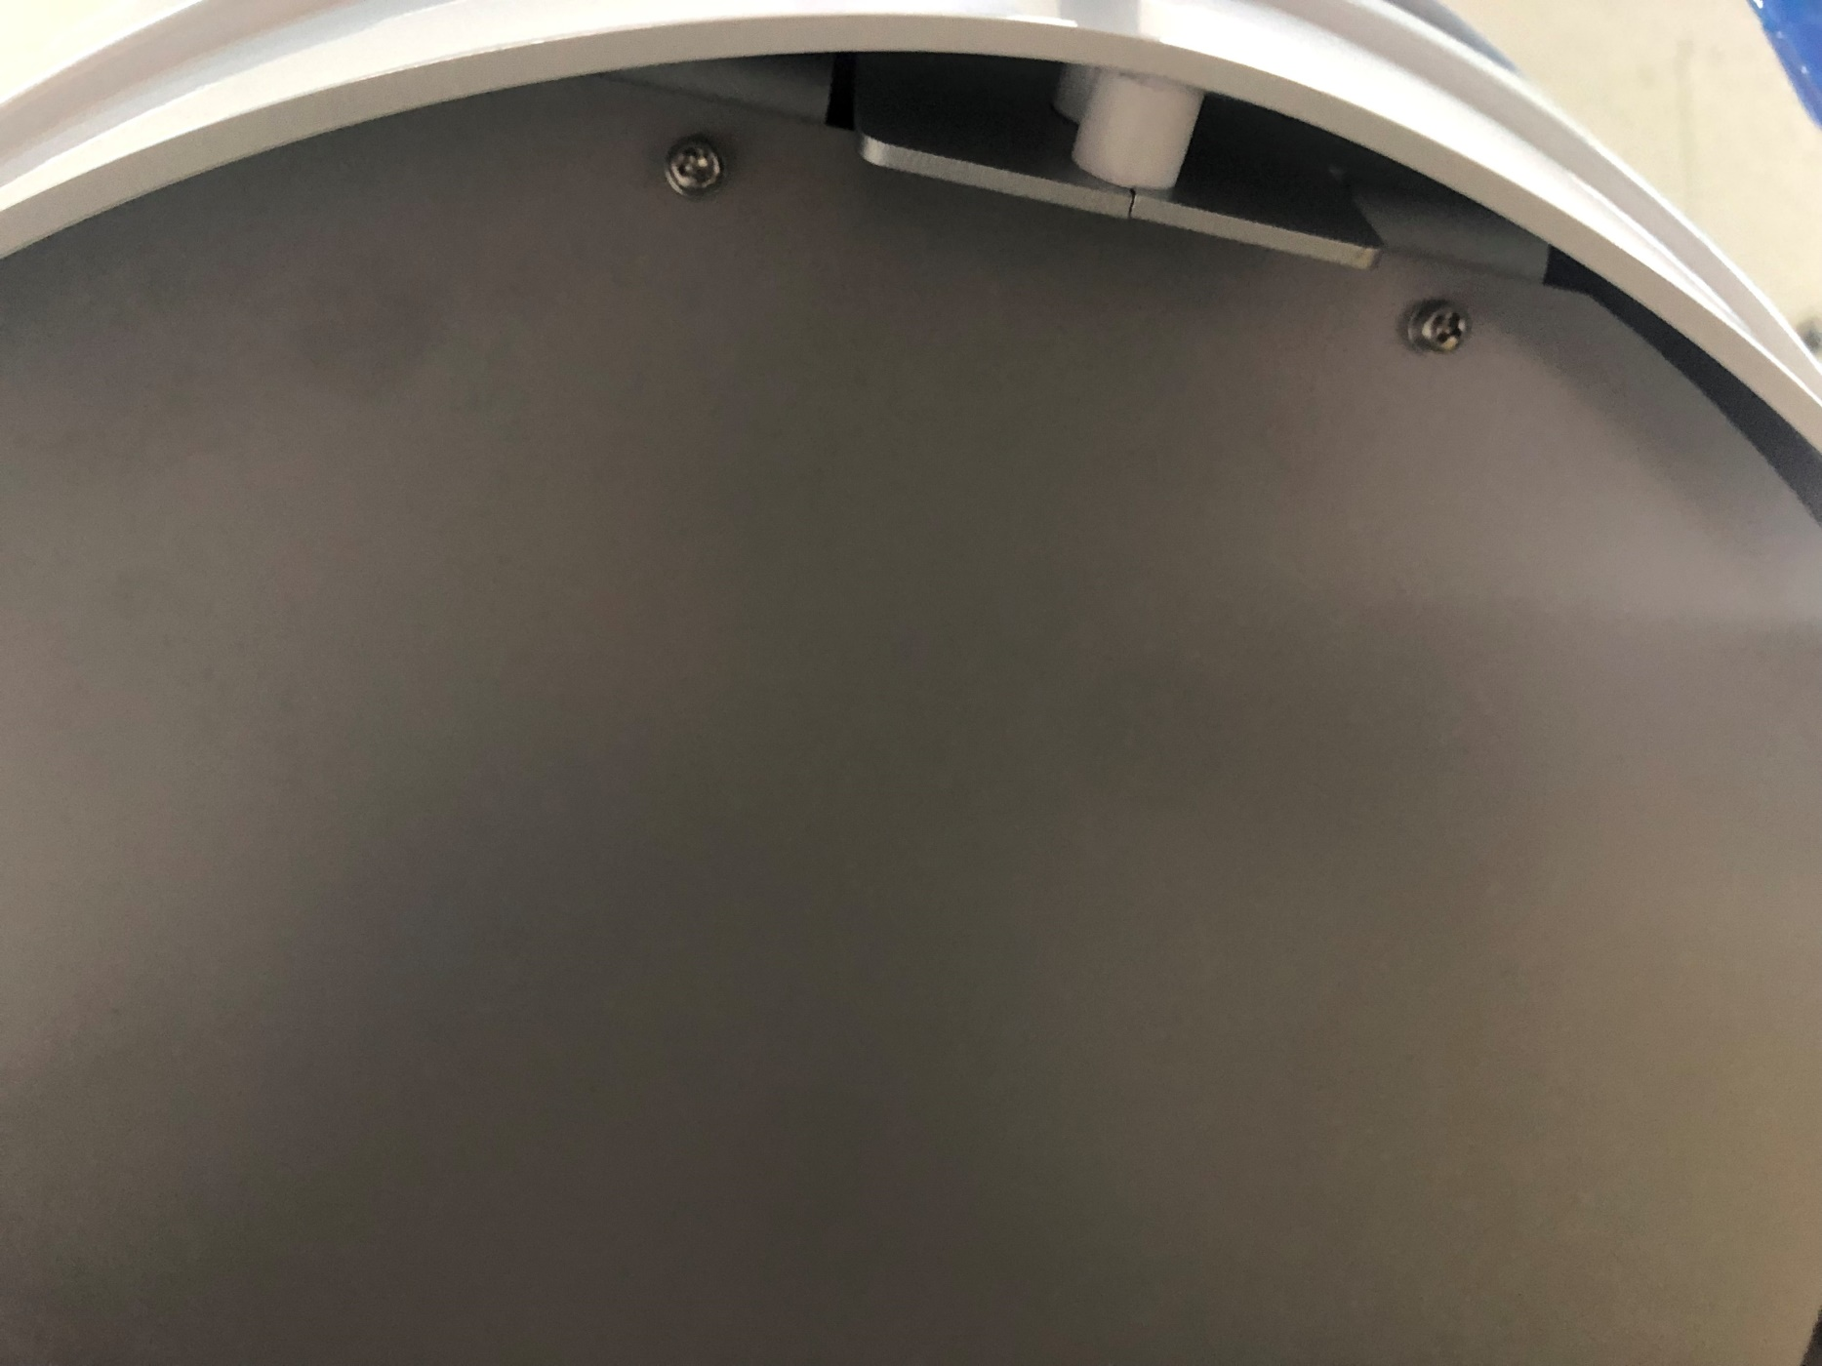
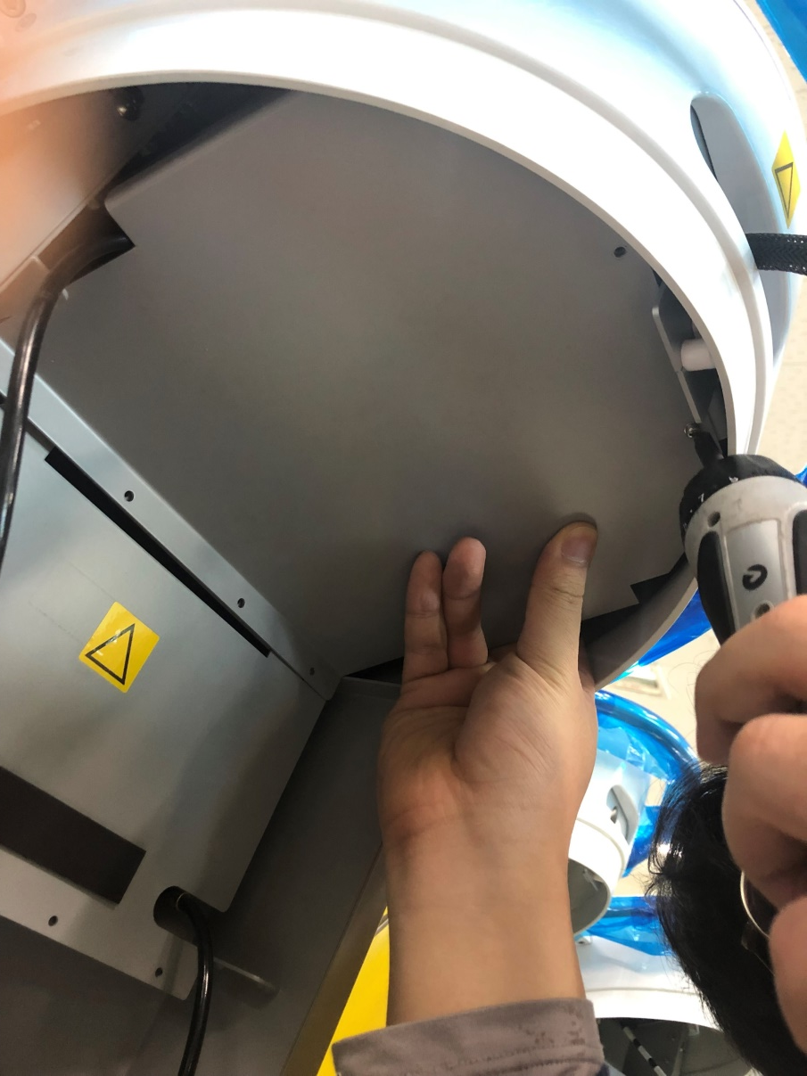
3 Unwind screw bolts on circle area

Slide 6
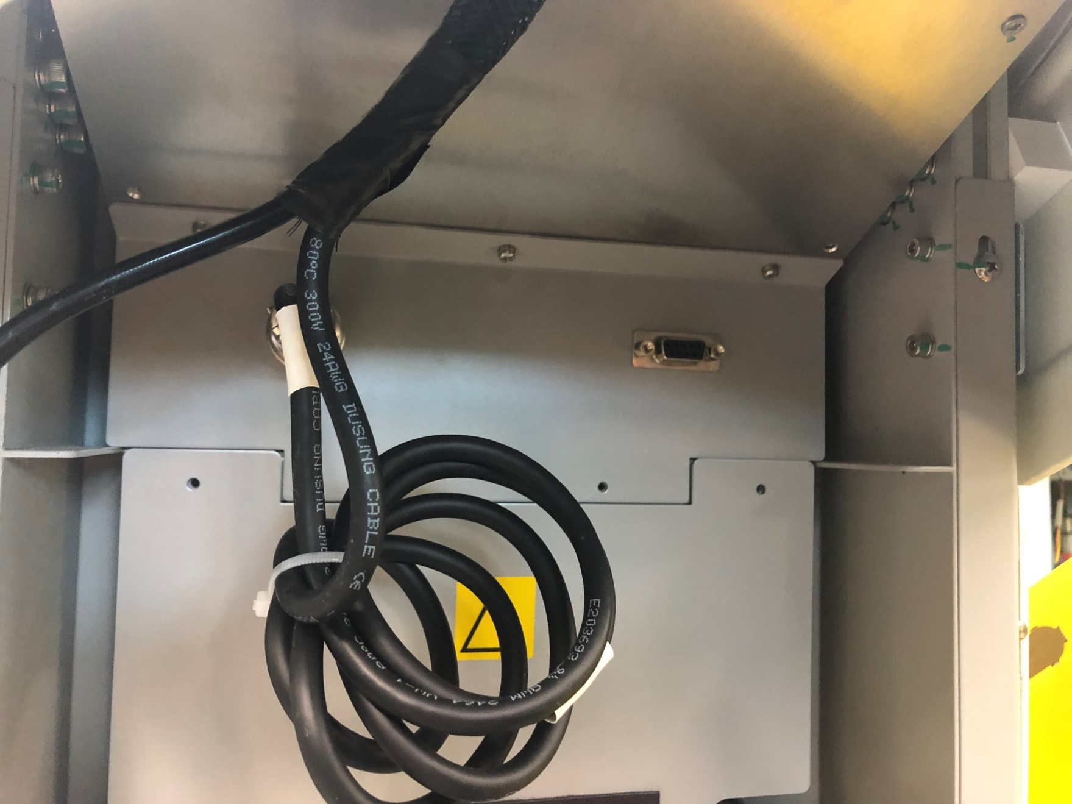
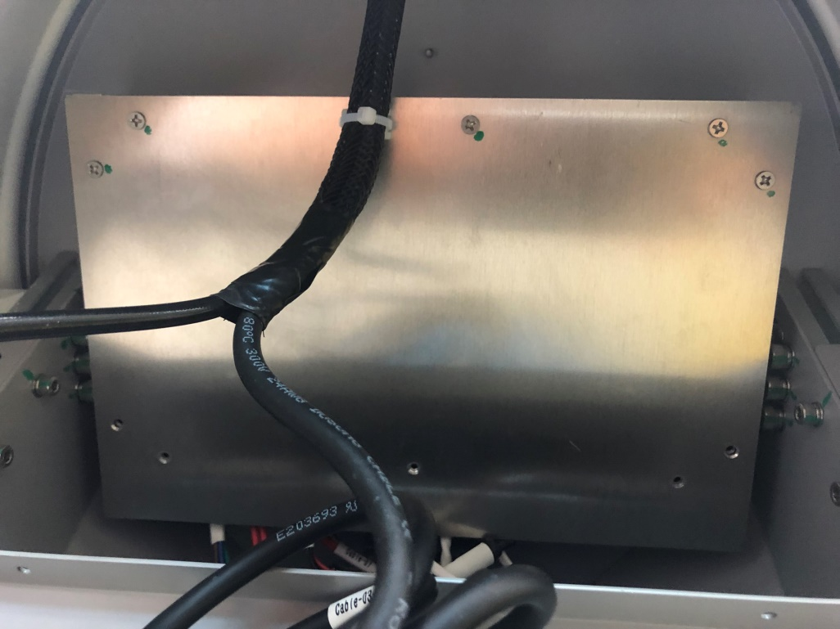
4 Unwind screw bolts on circle area
Already unwinded
overlapping screw on square area
because unwinded circled area (Left pic)
2 Triangle area, have no screw

Slide 7
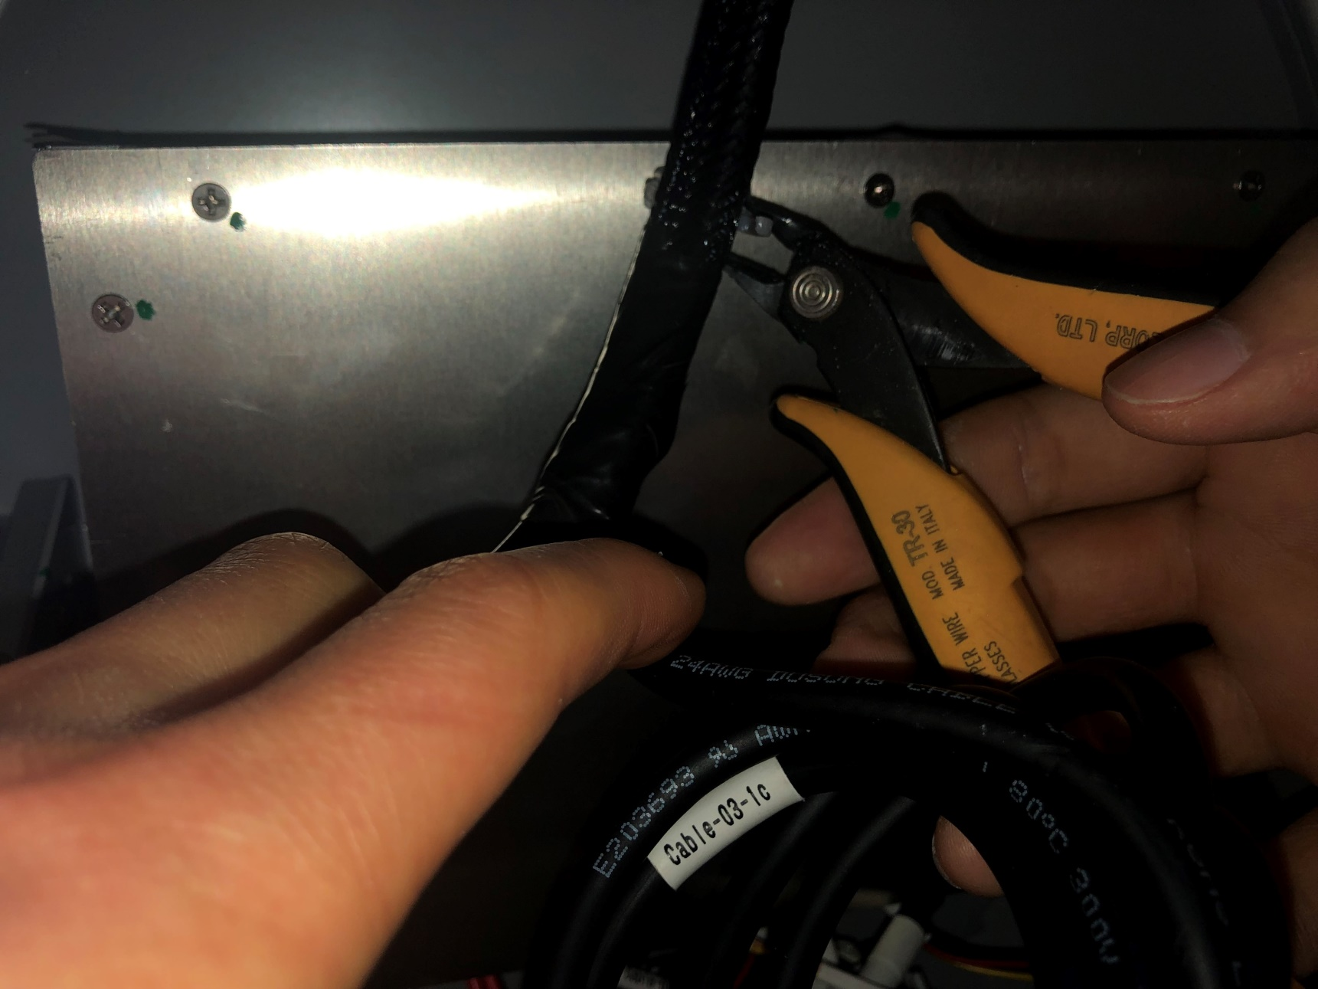
5 Cut cable tie and unwind screws on circle area <Part 1>

Slide 8


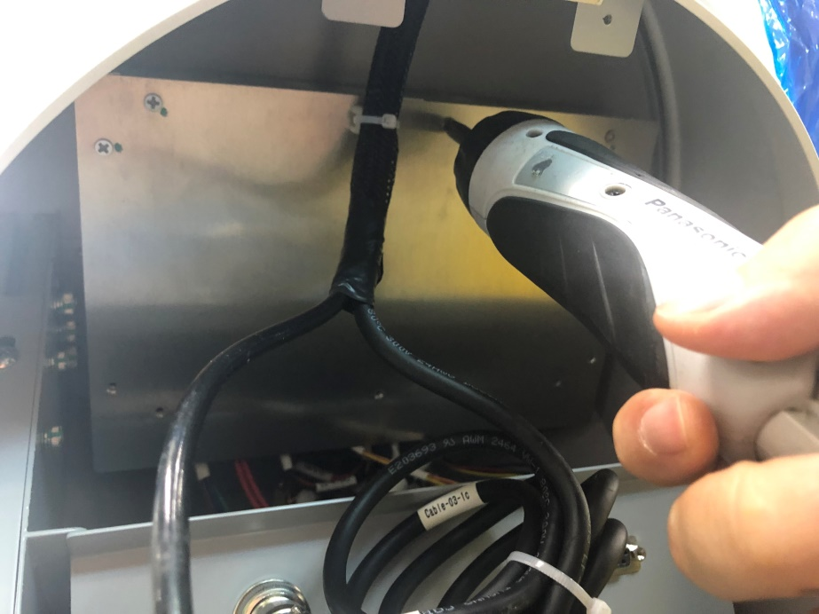
6 Cut cable tie and unwind screws on circle area <Part 2>

Slide 9
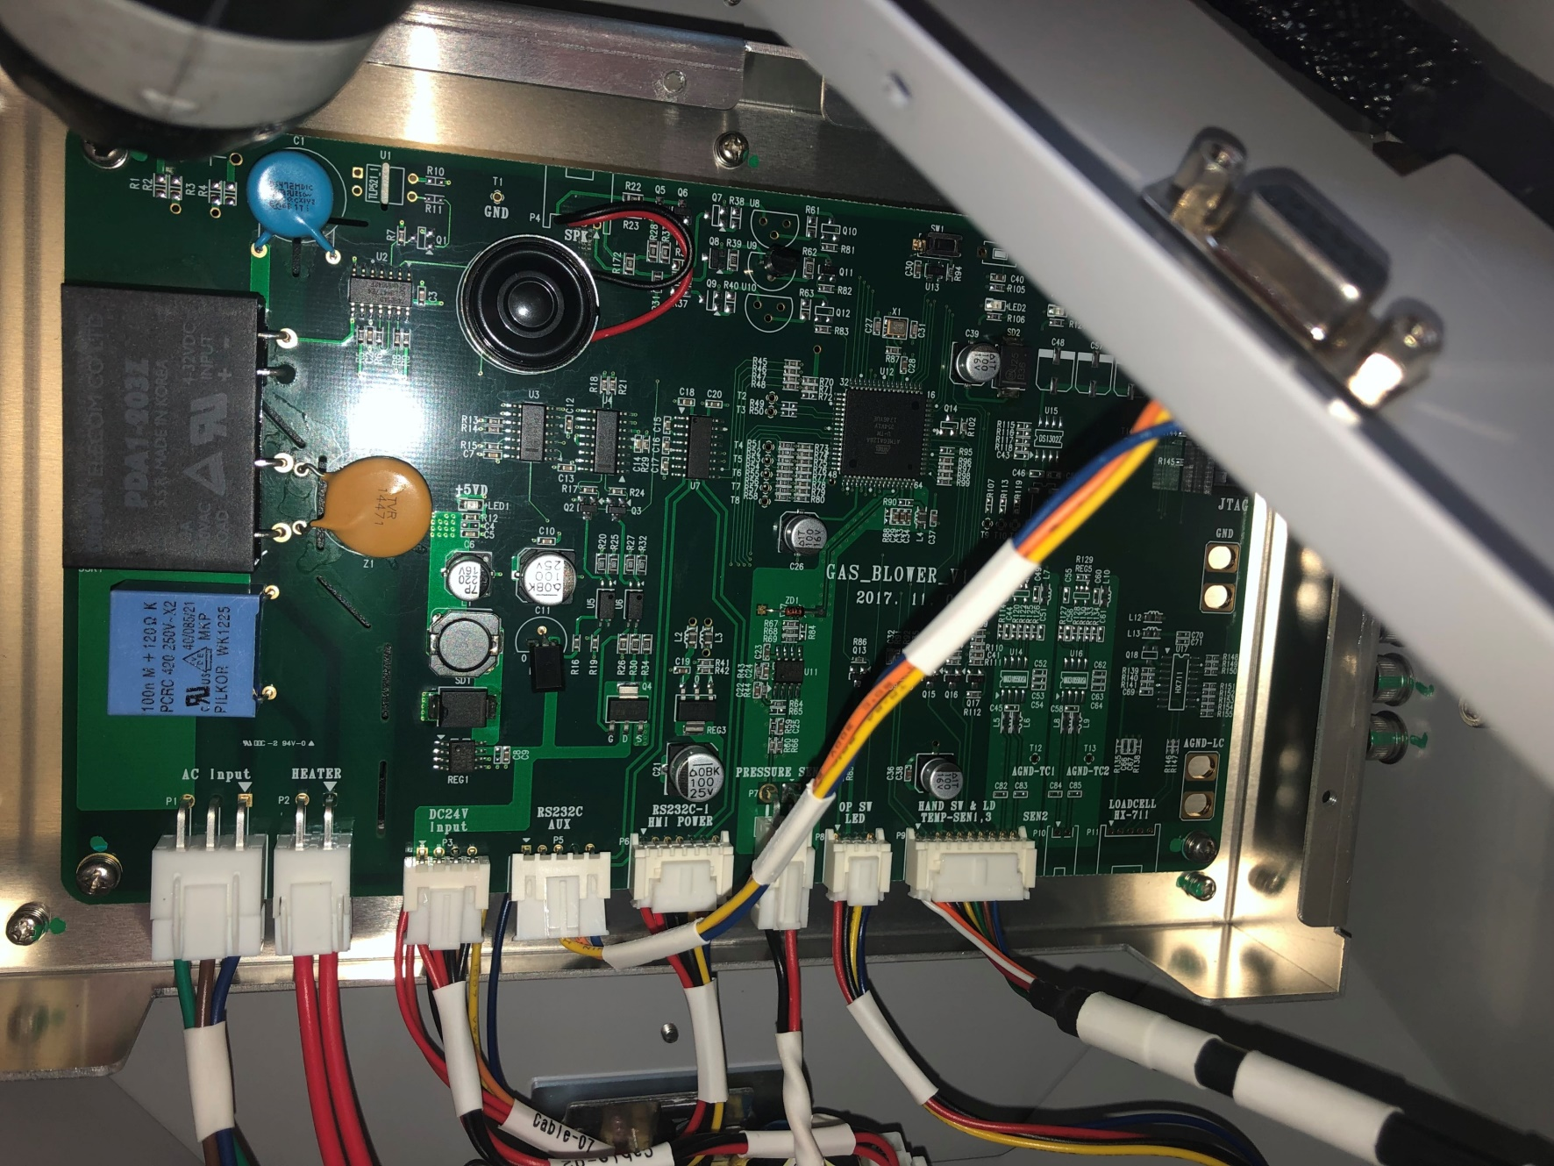
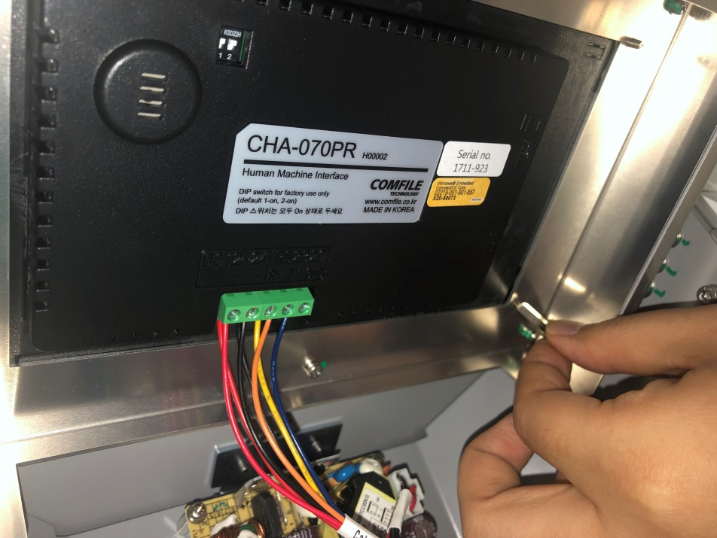
7 Unwind screw bolts on four corner of mother board <Part 1>
Wooops!
One corner side did not unwind well
<As you see below>

Slide 10
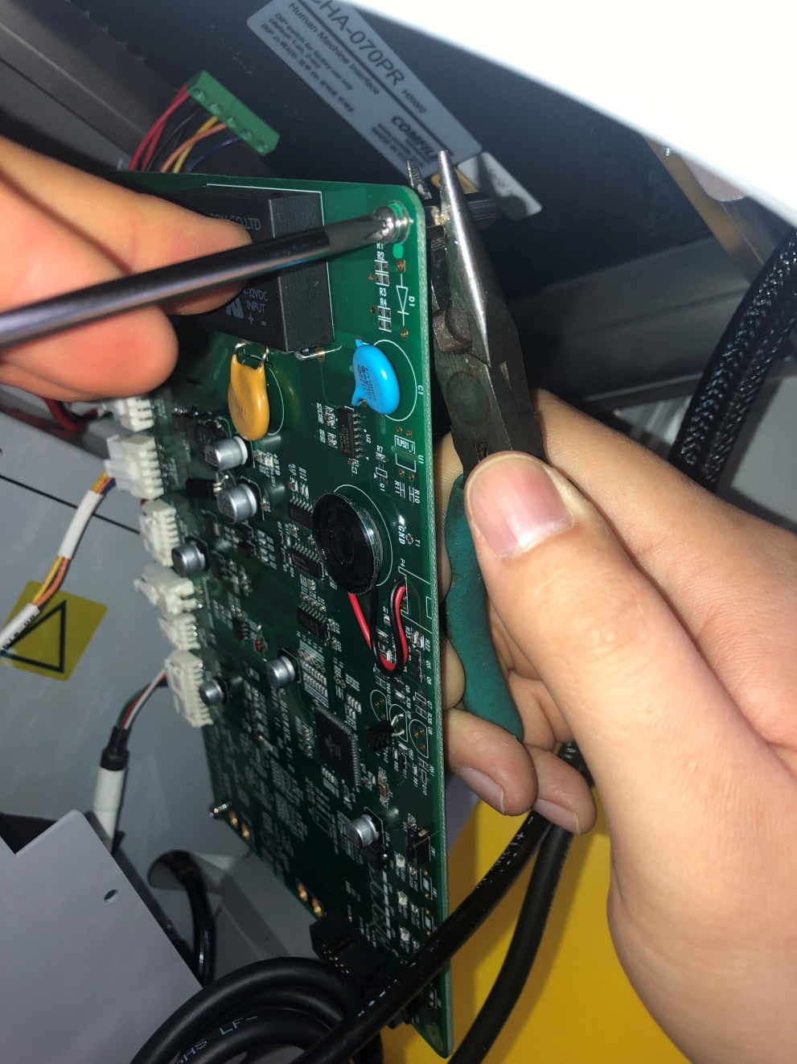
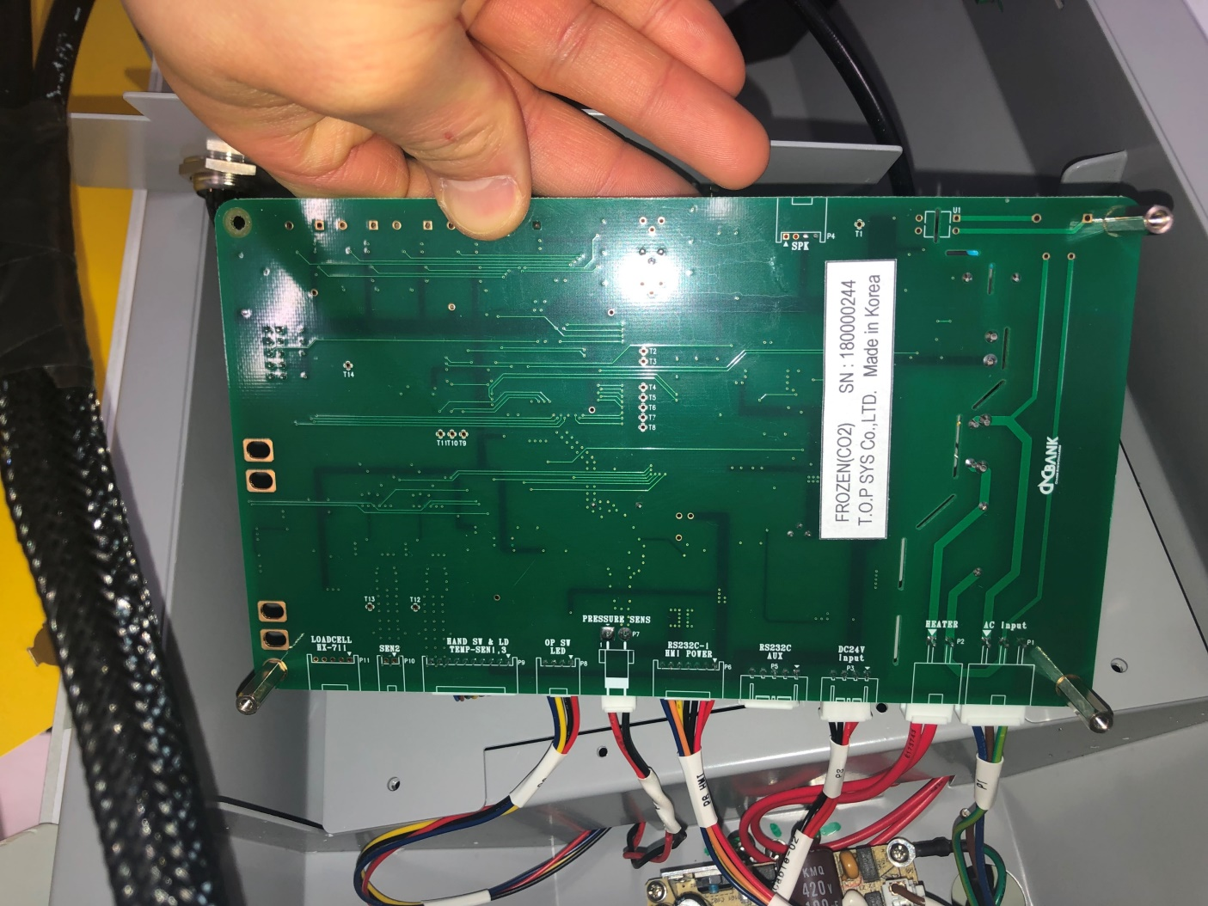
8 When corner did not unwind correctly.. <Part 2>
..Then please utilize 2. Long Nose Plier to unwind hexa nut

Slide 11
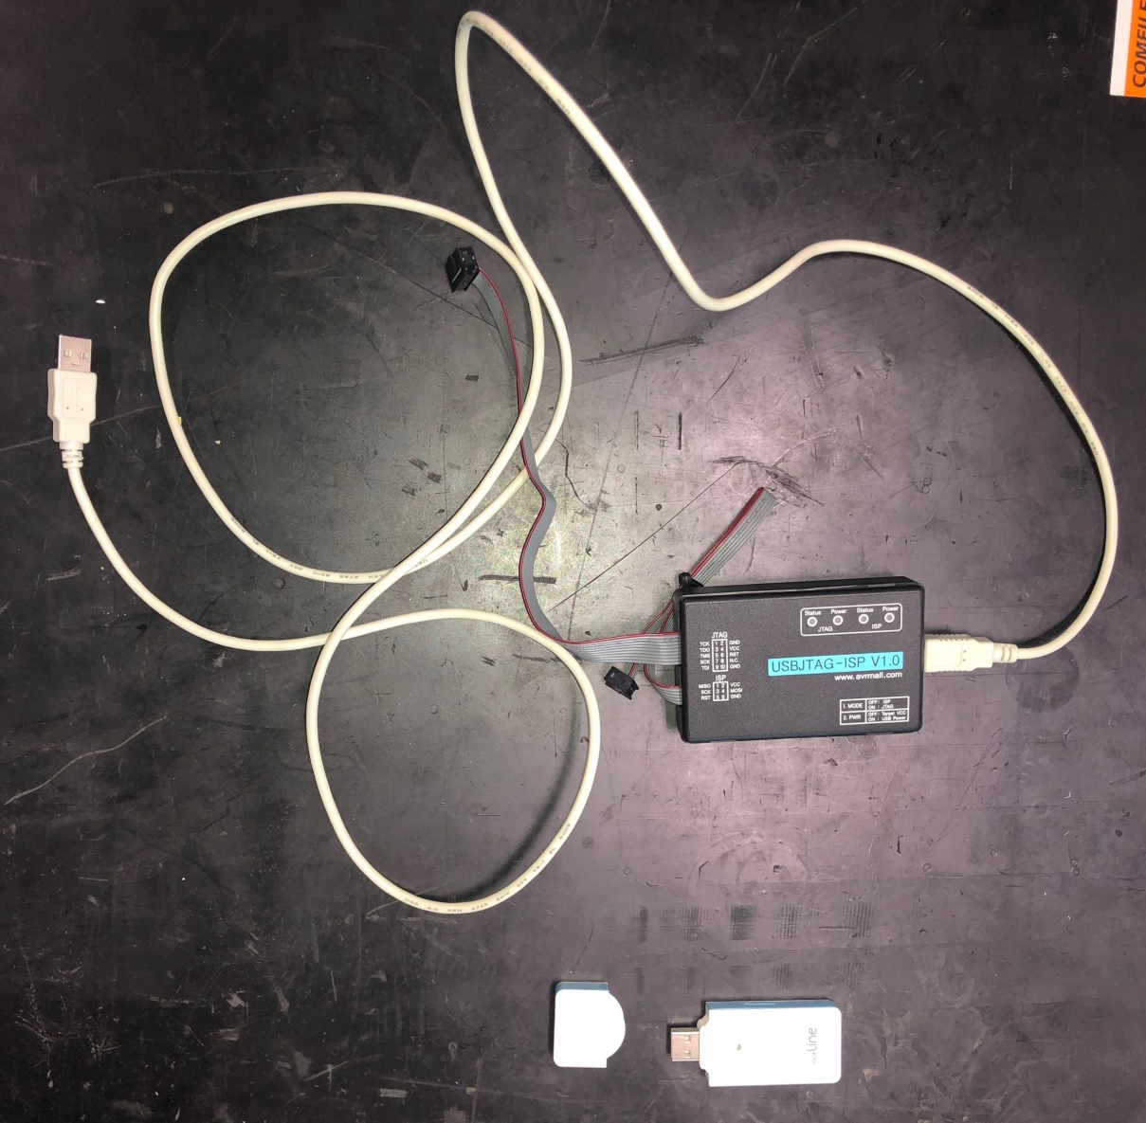
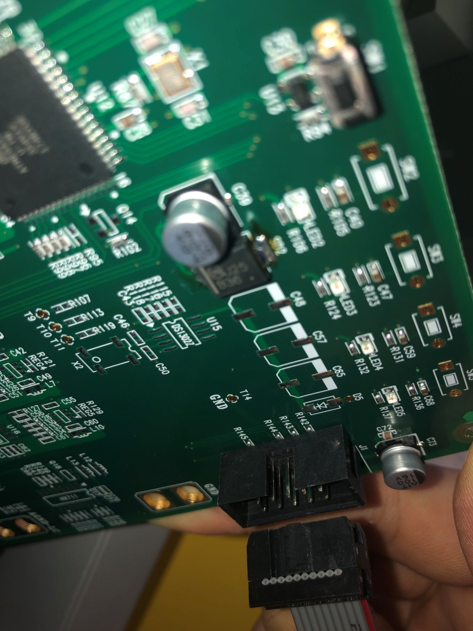
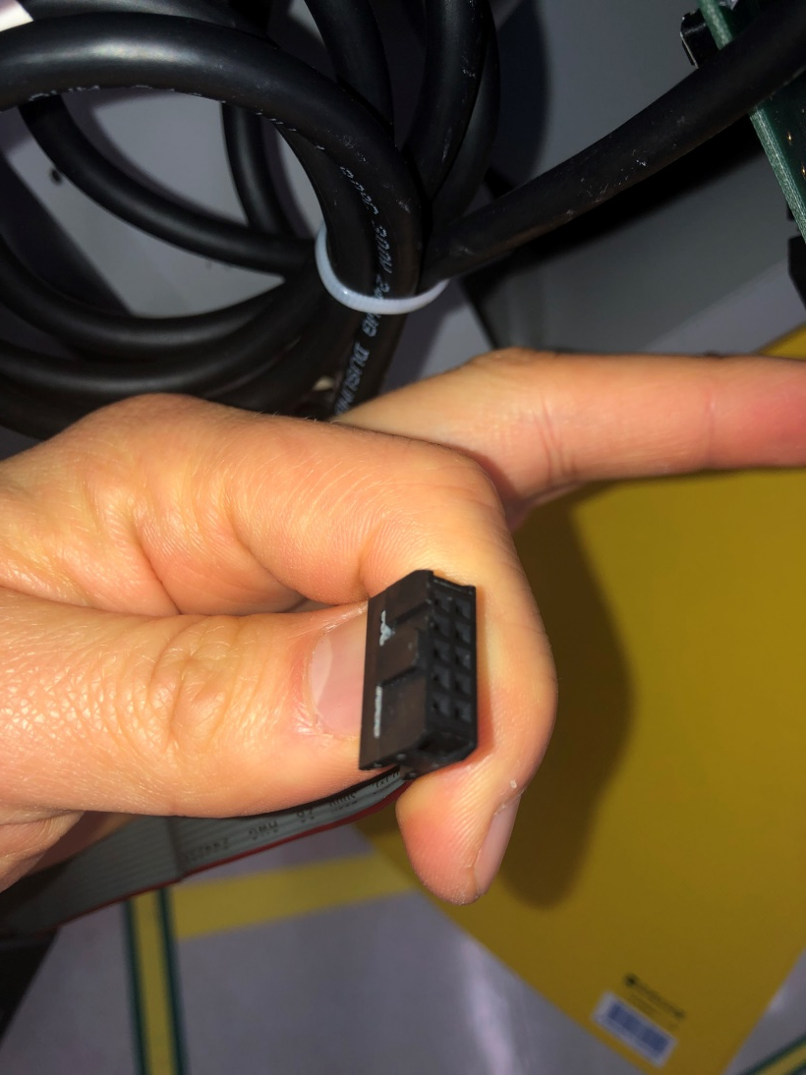
9 FIRMWARE UPGRADE KIT <USB JTAG><Part 1>

Slide 12
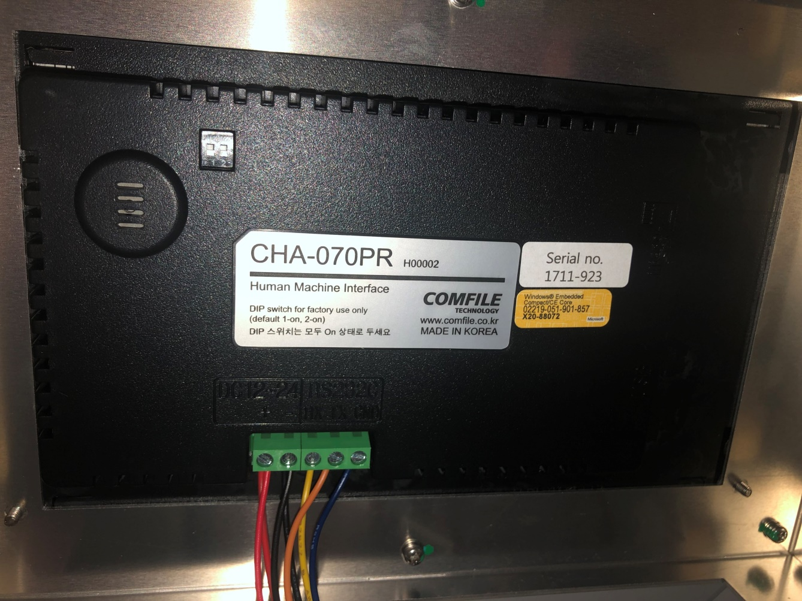
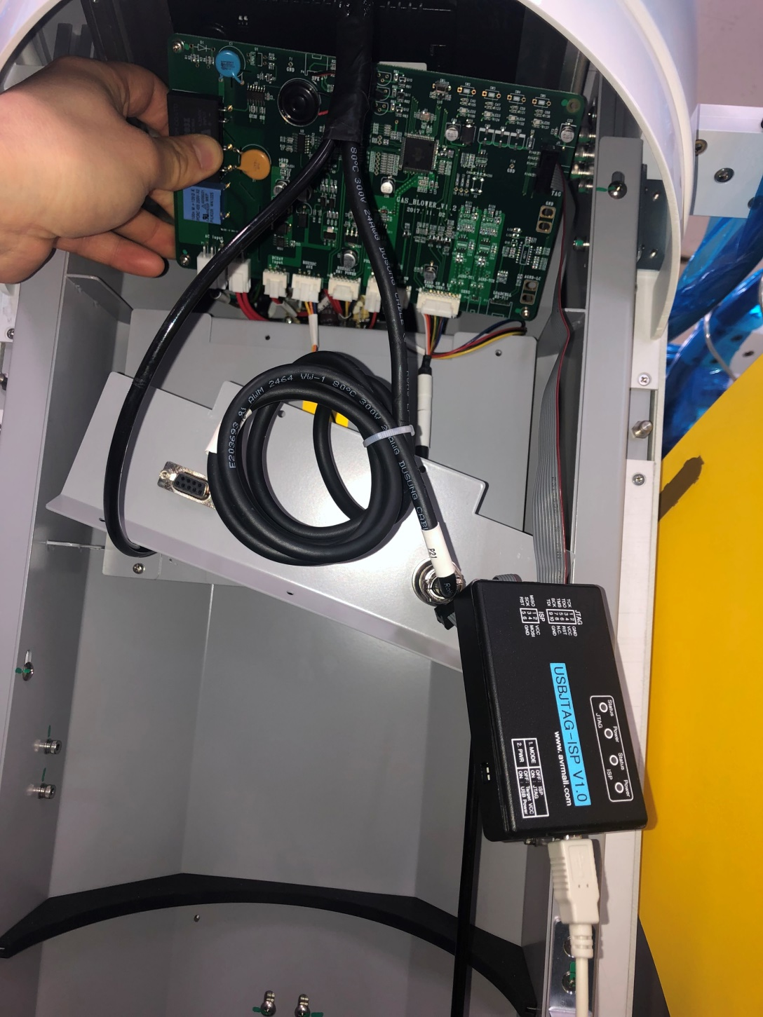
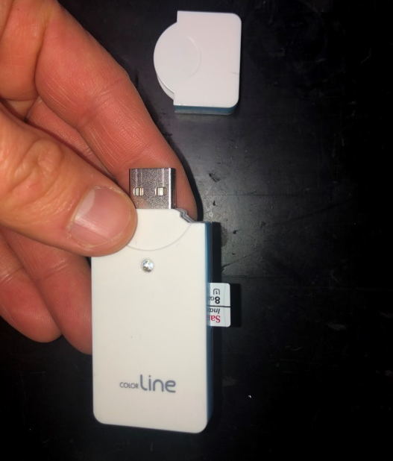
10 FIRMWARE UPGRADE KIT
FIRMWARE UPGRADE KIT <SD CARD>
<USB JTAG><Part 2>
Insert SD Card to USB SLOT
for upgrade ‘Display Program on
Touch Screen.’

Slide 13
11 FIRMWARE UPGRADE KIT <USB JTAG><Part 1>
Main Board
1. Download and Install Program
http://www.atmel.com/Images/AvrStudio4Setup.exe
2. USB Drive
http://www.neromart.co.kr/goods/view?no=3437
3. AC Power off.
4. Connection USB JTAG
5. AC Power on
6. Program Hex file
7. Program fuse bit
8. AC Power off and on
LCD
1. AC Power off
2. LCD update
3. AC Power on

Slide 14
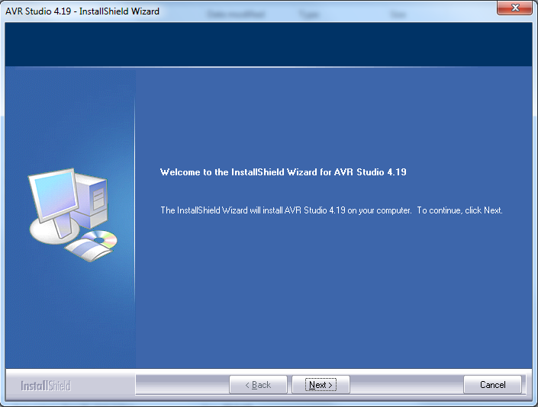
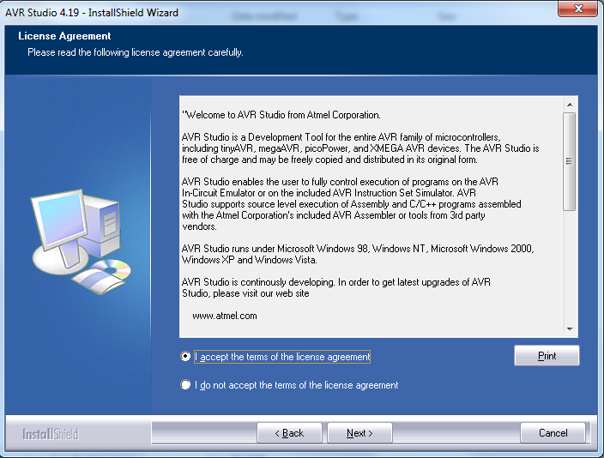

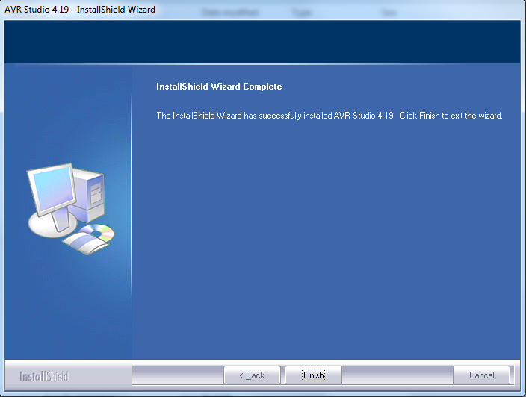
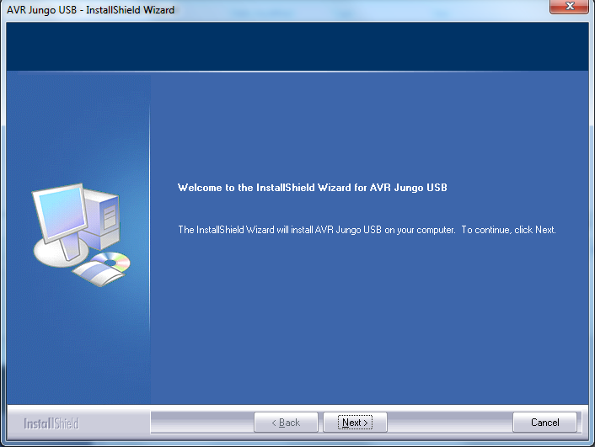
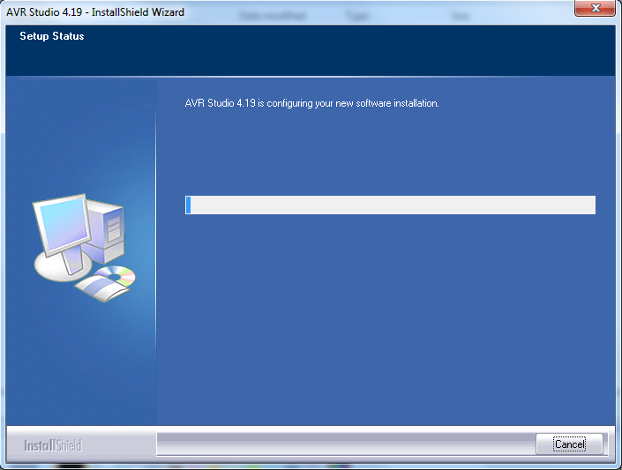
11-1 FIRMWARE UPGRADE KIT : Install AVR Studio

Slide 15
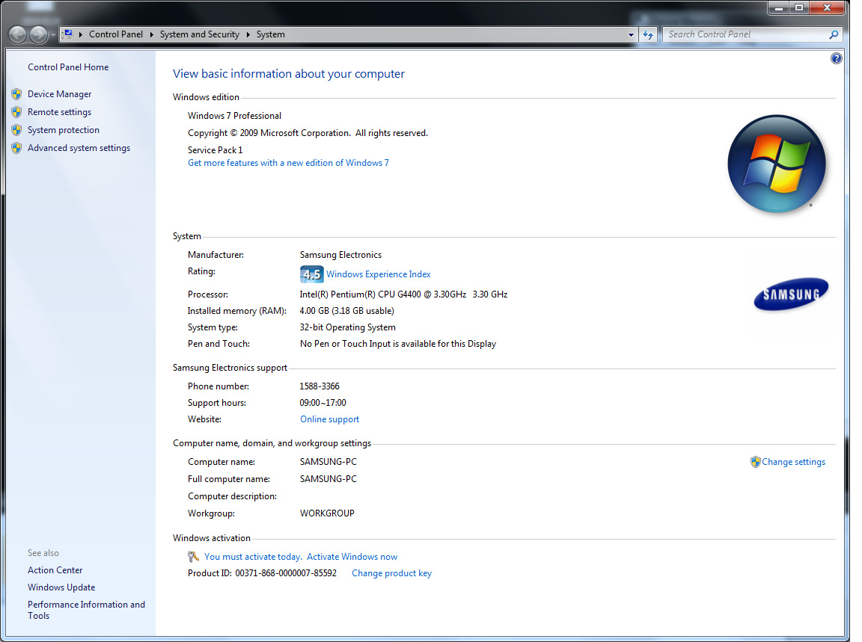
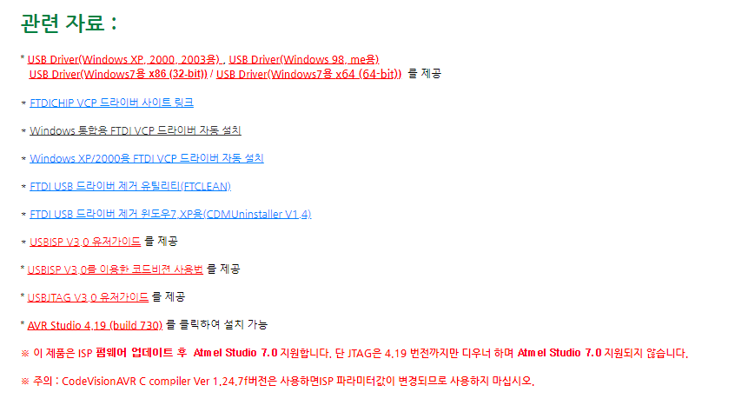
11-2-1 FIRMWARE UPGRADE KIT : USB Driver update
Window version check
Select Driver

Slide 16
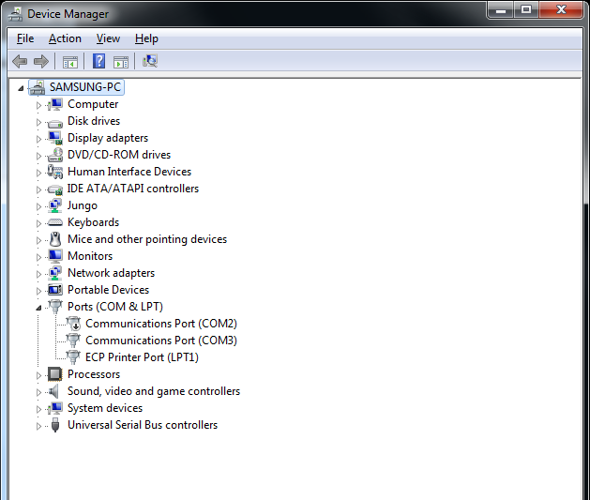
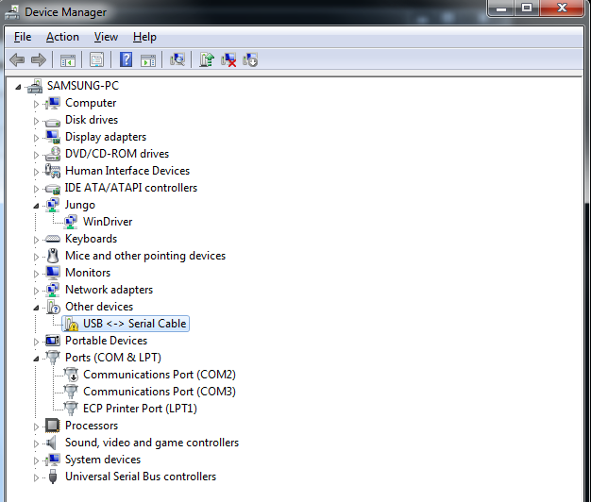
11-2-2 FIRMWARE UPGRADE KIT : USB Driver update
Unconnected USB JTAG
Connected USB JTAG
Not installed Driver

Slide 17
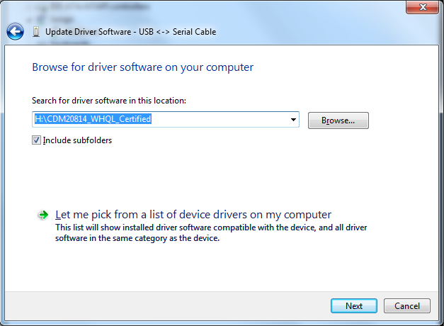
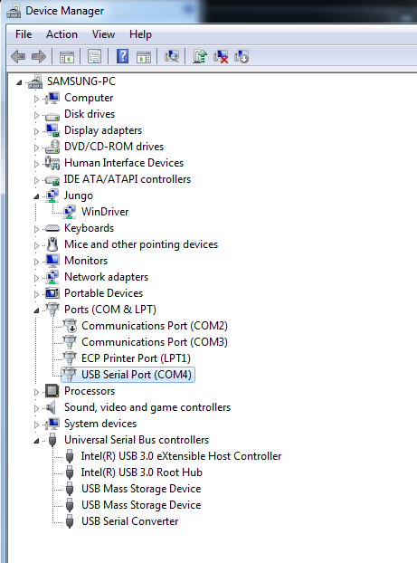
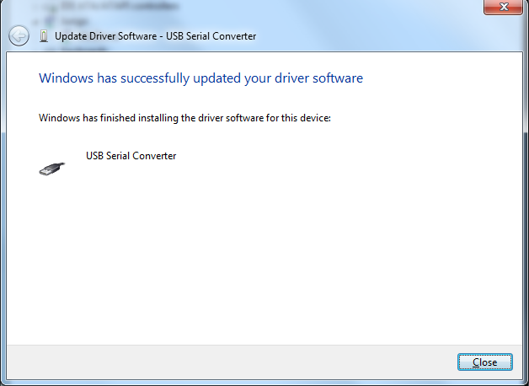
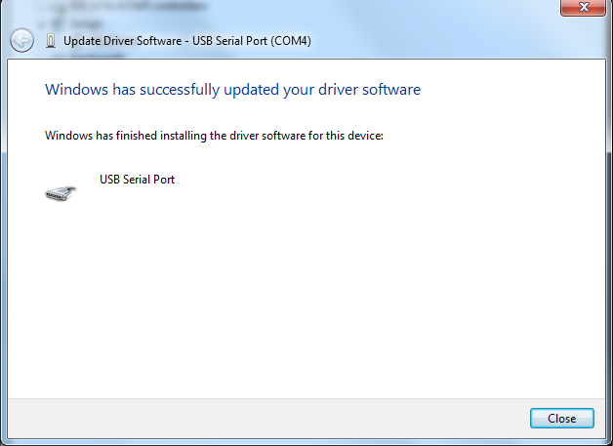
11-2-3 FIRMWARE UPGRADE KIT : USB Driver update
Update Driver converter
Update Driver Serial Port
Finish Driver

Slide 18
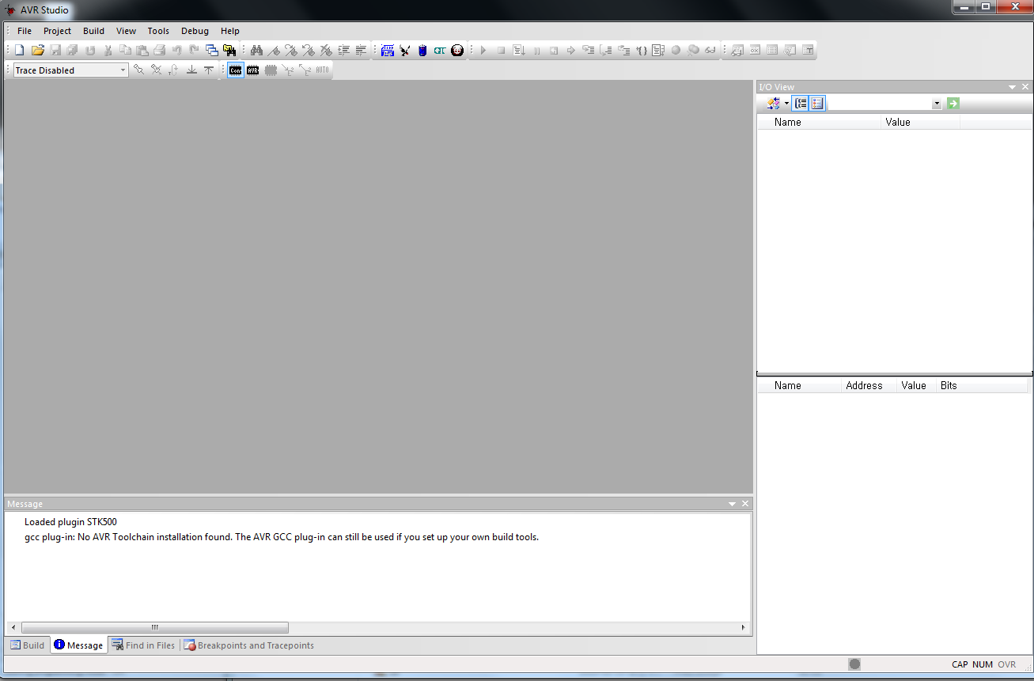
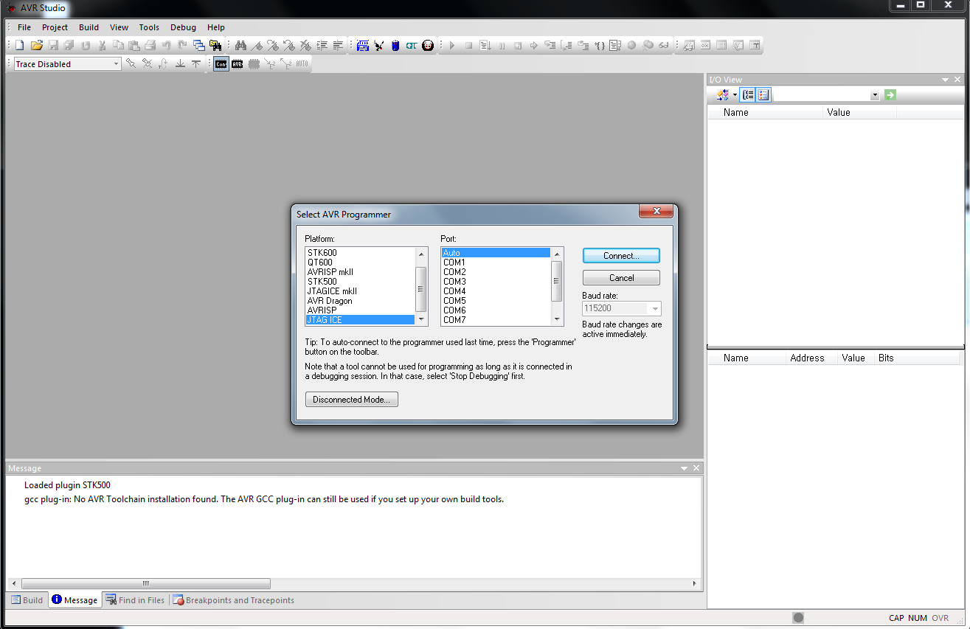
11-6-1 FIRMWARE UPGRADE KIT : AVR Studio
Execute AVR STUDIO
Connection : JTAGICE Auto

Slide 19
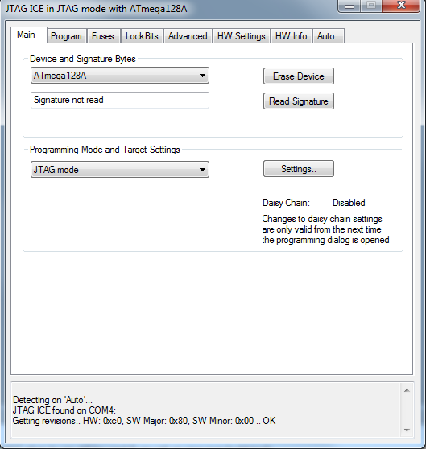
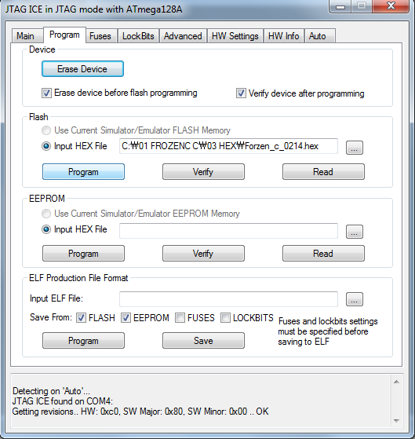
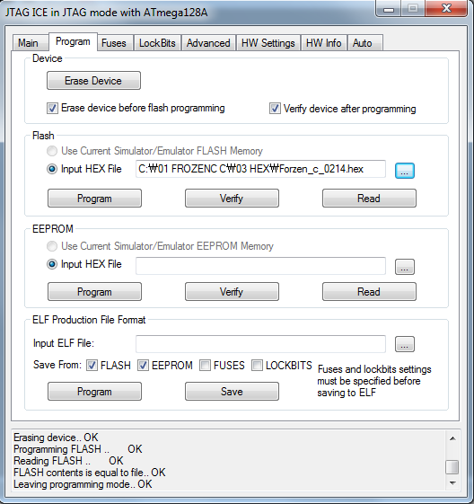
11-6-2 FIRMWARE UPGRADE KIT : AVR Studio
Main : Select MCU
ATmega128A
Program : Select HEX file
Program : Program HEX file
Check Message window

Slide 20
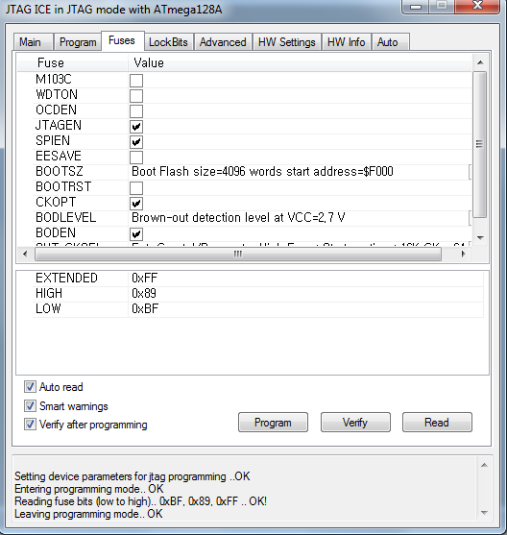
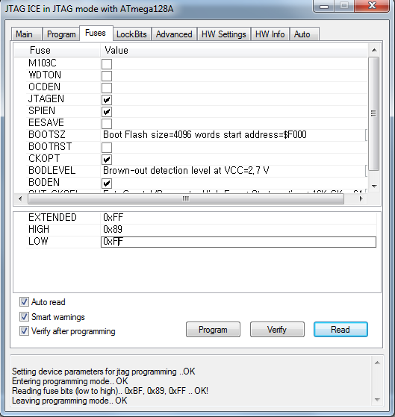
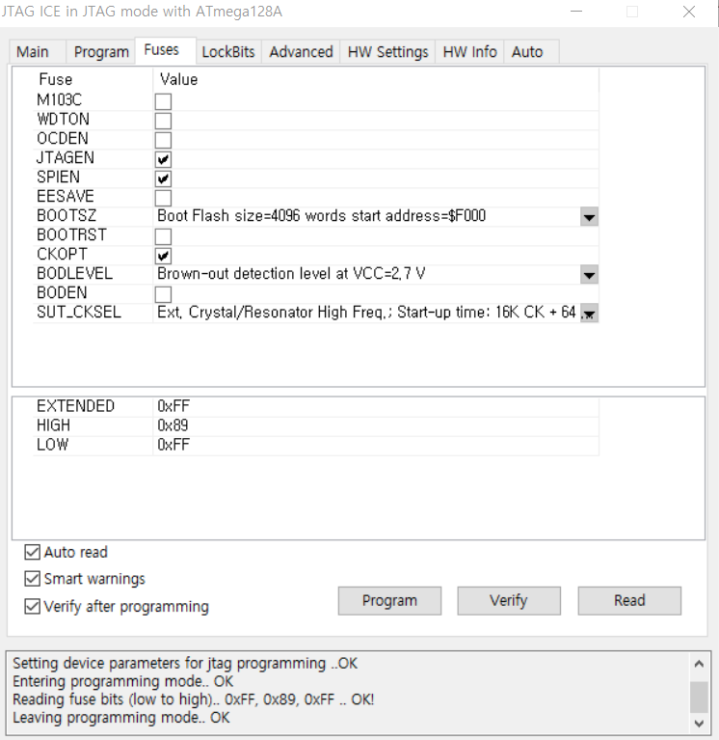
11-6-3 FIRMWARE UPGRADE KIT : AVR Studio
Read click
Fuses : Double click
Fuses : enter FF
Program click
Verify click
Read click

Slide 21
11-11-1 FIRMWARE UPGRADE KIT : LCD Update
AC Power off
Remove the SD card from the LCD.
Insert SD Card into USB.
Copy the FILE to the SD card.
Insert the copied SD card into the LCD.
AC Power on

Slide 22
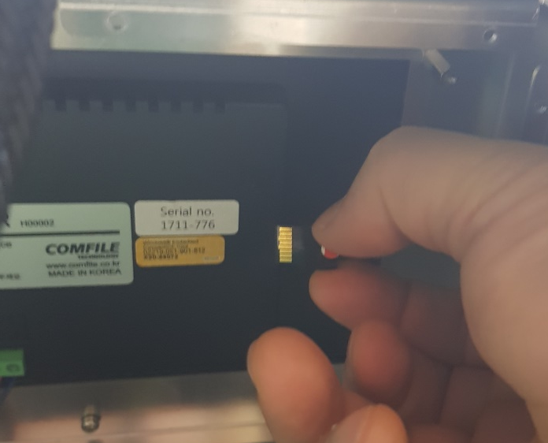
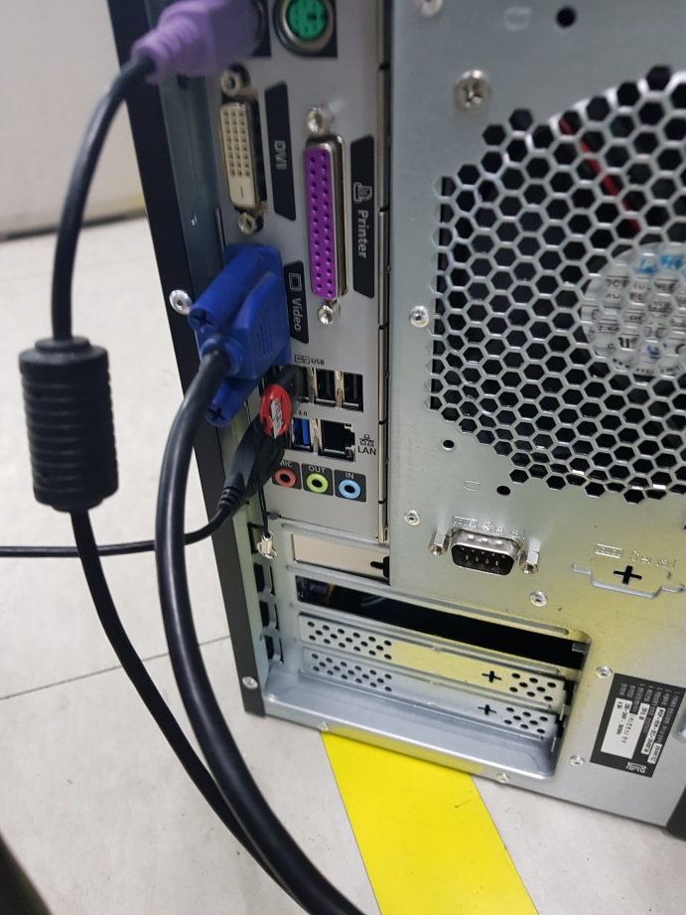
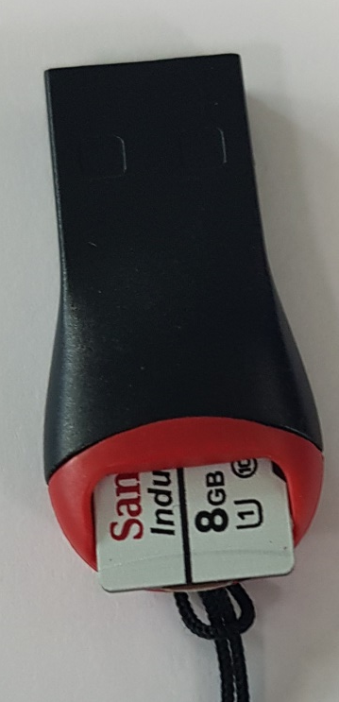
11-11-2 FIRMWARE UPGRADE KIT : LCD Update

Slide 23
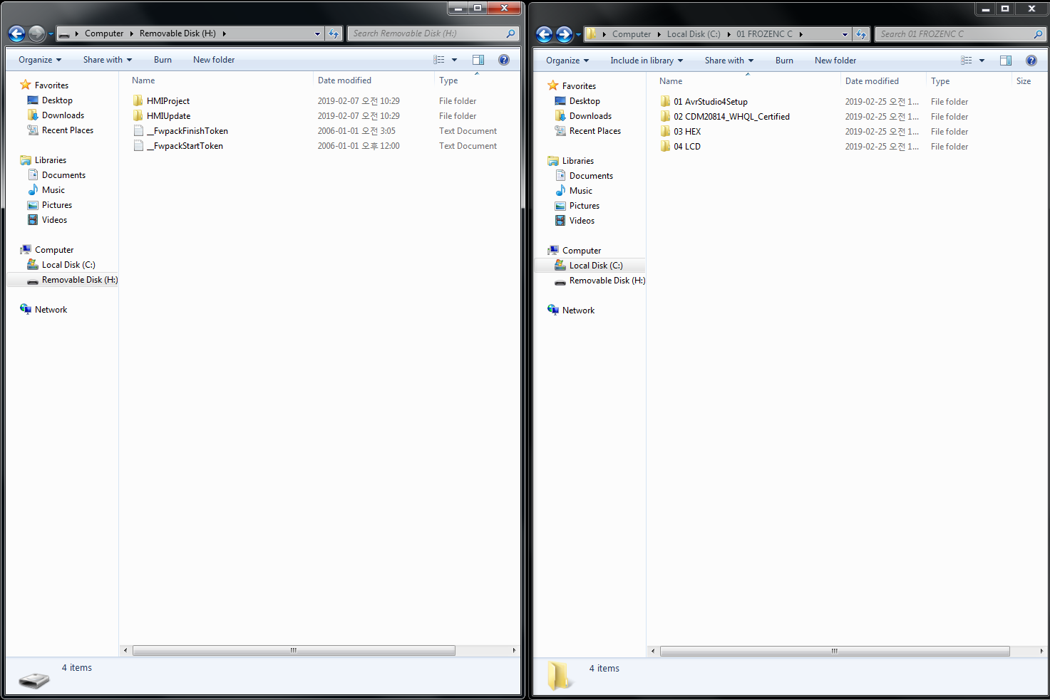
11-11-3 FIRMWARE UPGRADE KIT : LCD Update : Open
USB SD Card
PC File

Slide 24
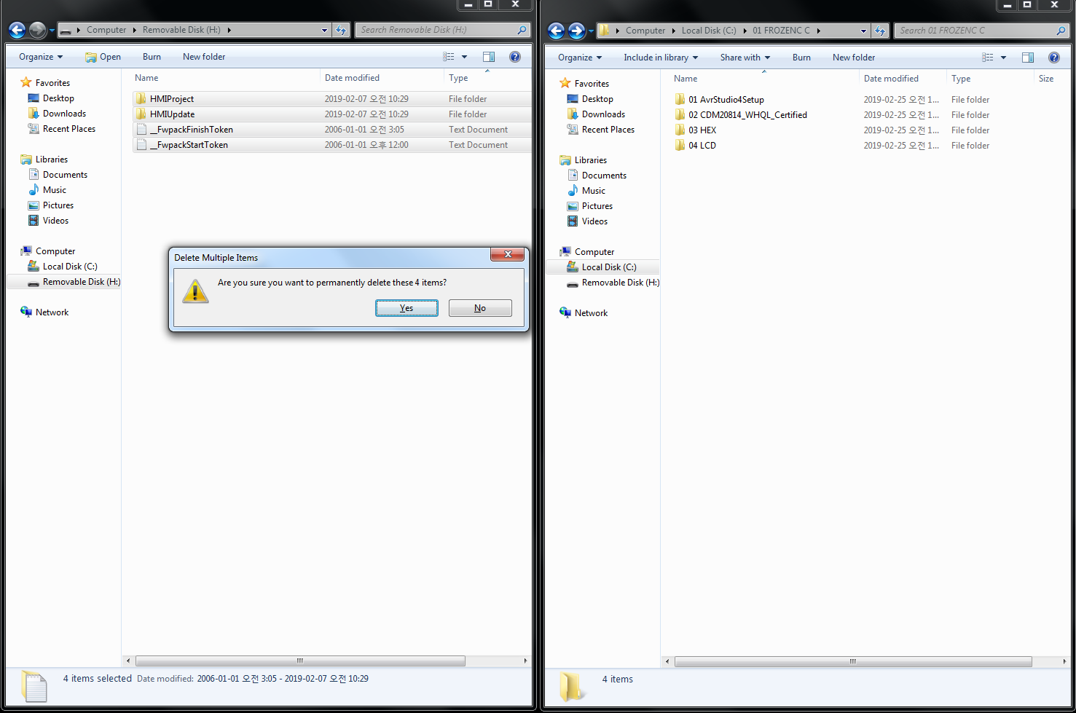
11-11-4 FIRMWARE UPGRADE KIT : LCD Update , Remove old file.
USB SD Card
PC File

Slide 25
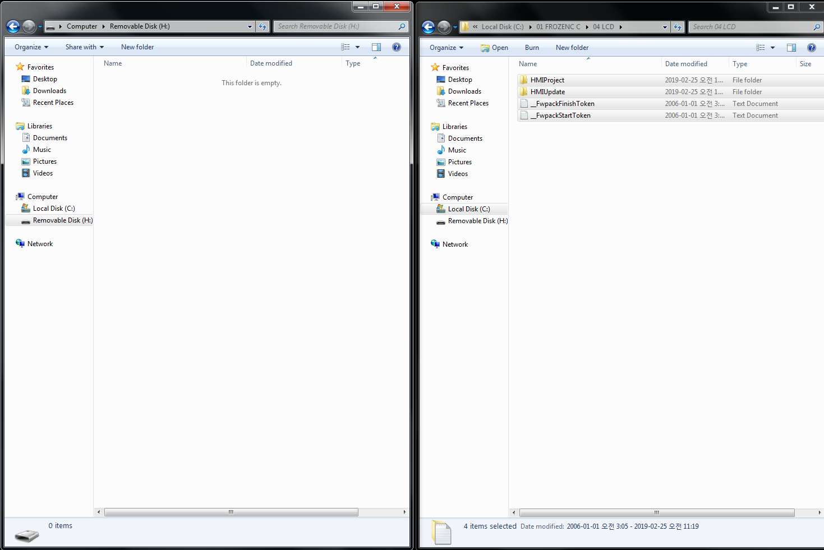
11-11-5 FIRMWARE UPGRADE KIT : LCD Update : delete
USB SD Card
PC File

Slide 26
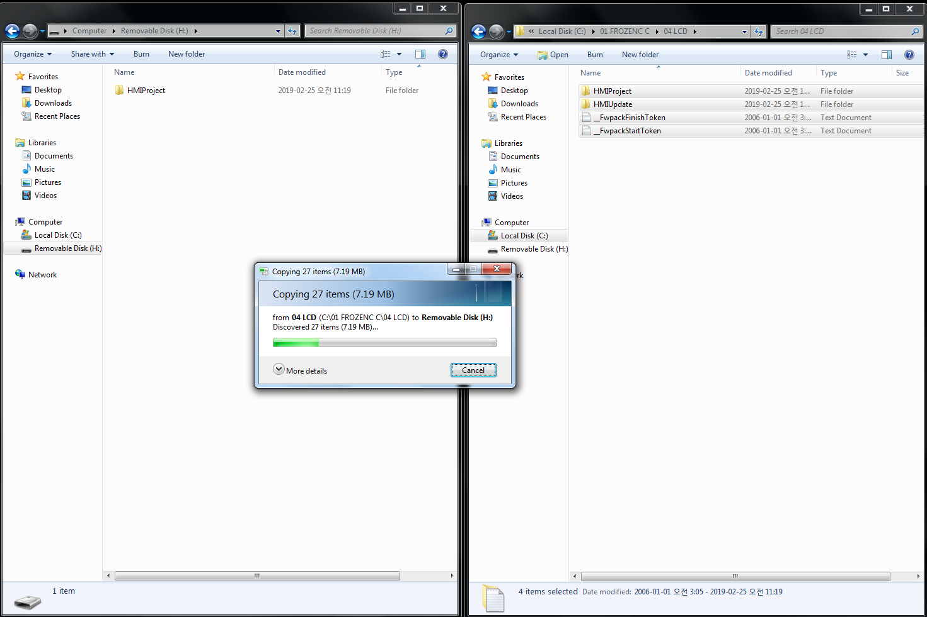
11-11-6 FIRMWARE UPGRADE KIT : LCD Update, Copy New file
USB SD Card
PC File

Slide 27
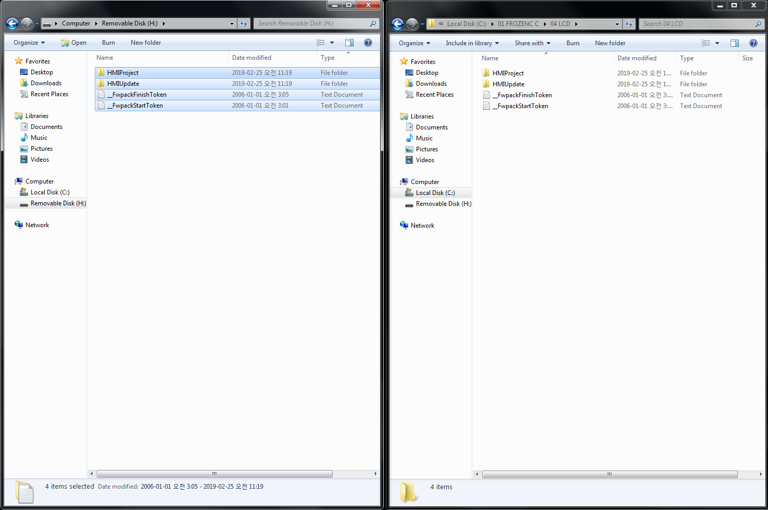
11-11-7 FIRMWARE UPGRADE KIT : LCD Update : Copy finish.
USB SD Card
PC File

Slide 28


12- Operation FROZEC C
AC Power ON -> Push Start SW
Main
SETUP

Slide 29


12- Operation FROZEC C
SETUP-> Factory SETUP
Factory SETUP
1234
Factory SETUP

Slide 30



12- Operation FROZEC C
AC Power OFF -> AC Power ON -> Push Start SW
Main
Blink and click
Residual SETUP and Main

